Slide 1
Introduction to programming

Slide 2
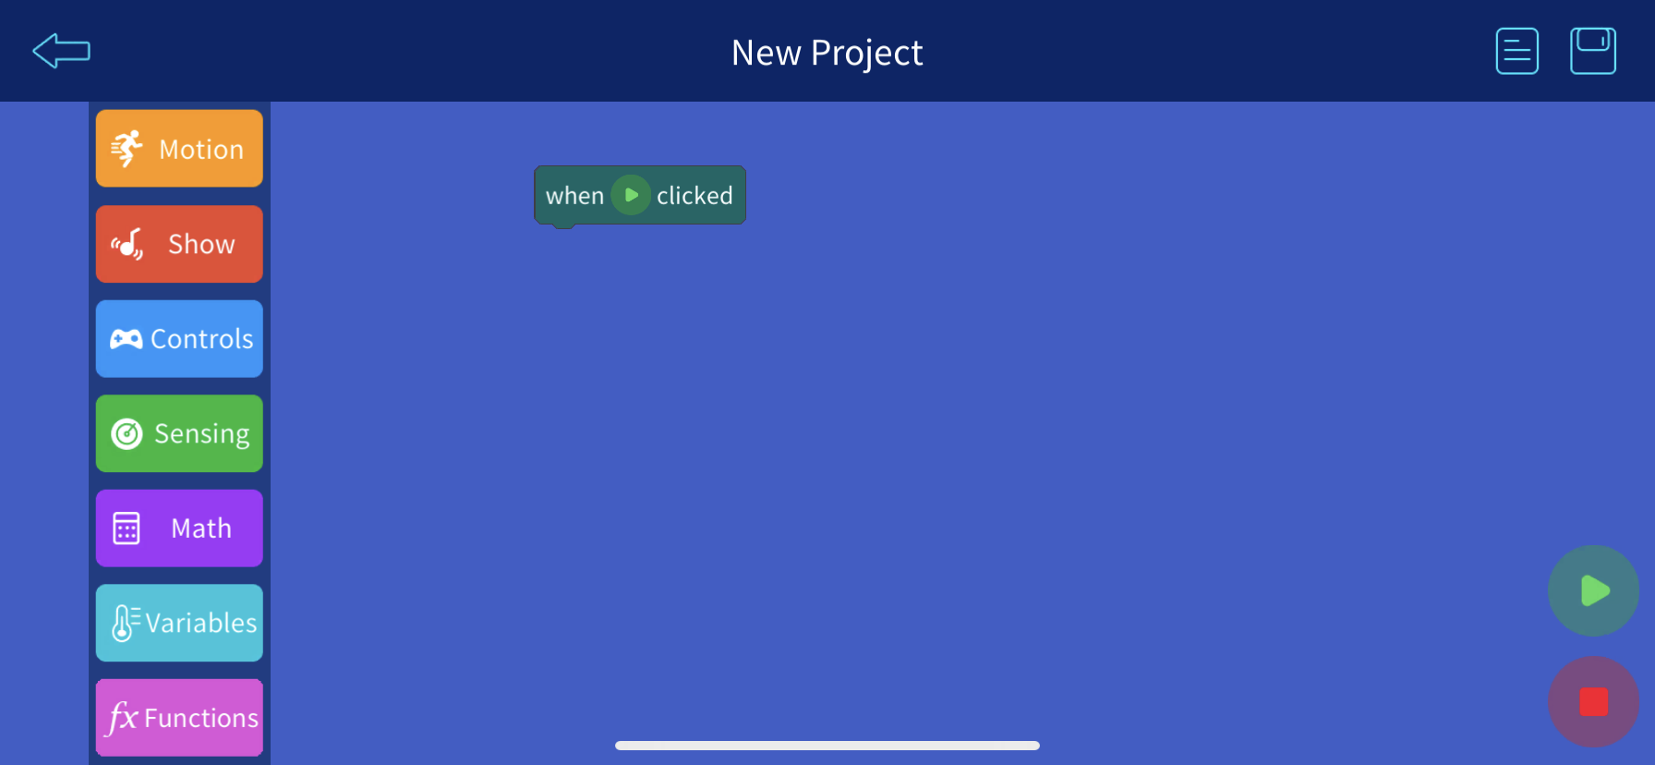
Interactive programming
We will use scratch https://scratch.mit.edu/
Scratch is :
high-level block-based visual programming language
Easy to understand concepts

Slide 3
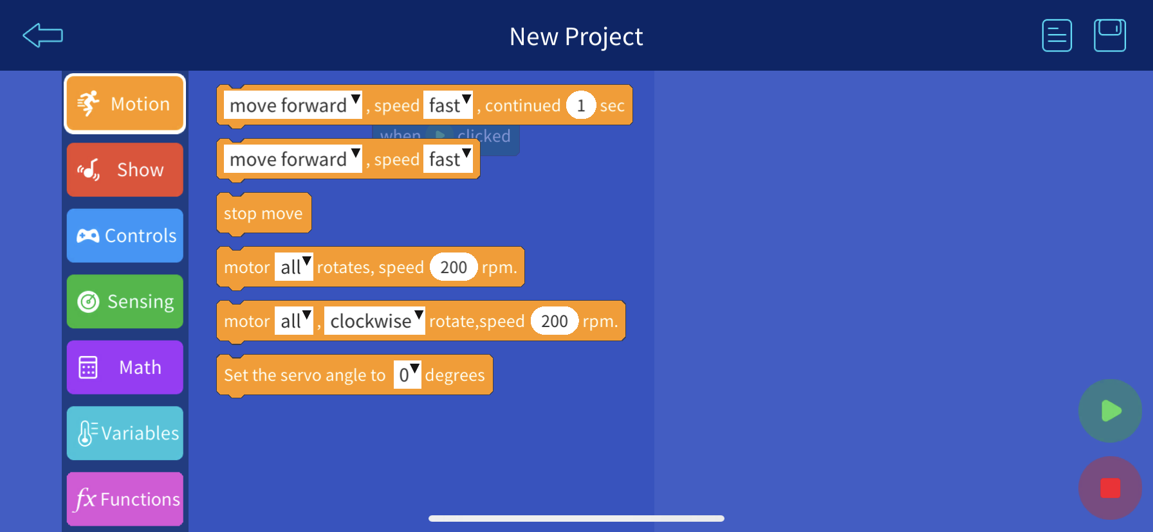
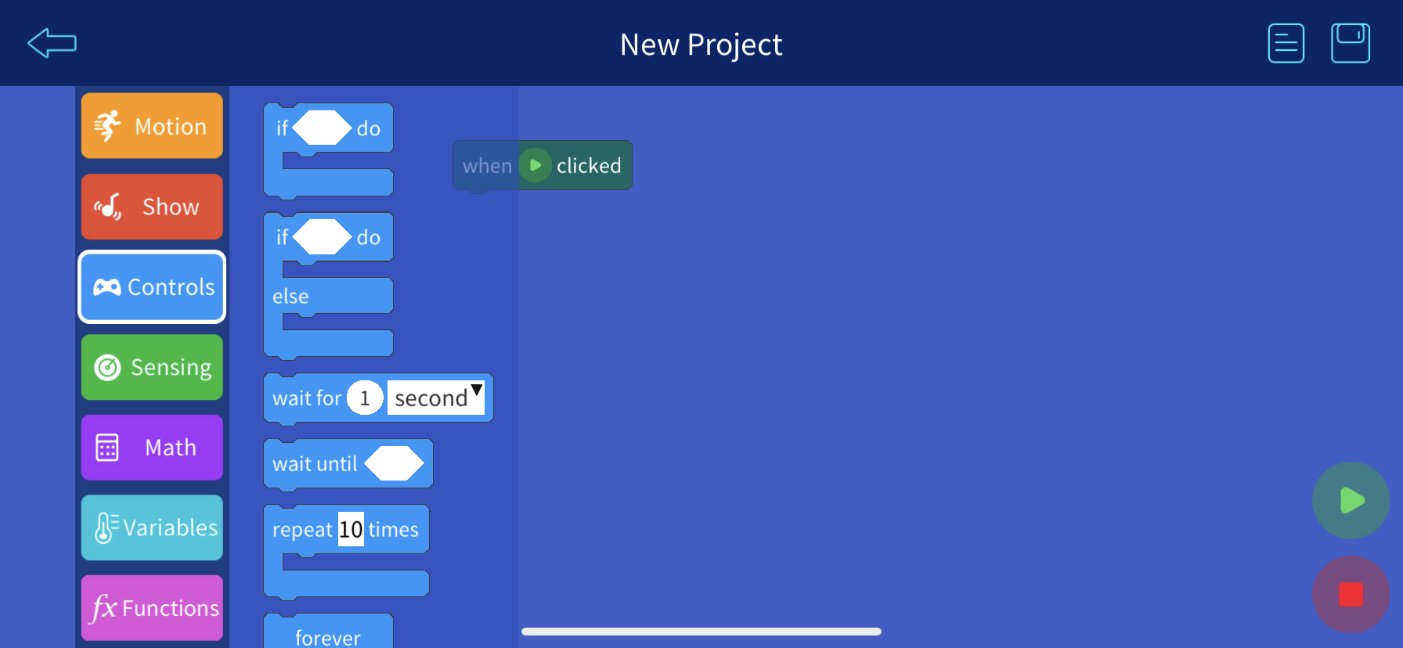
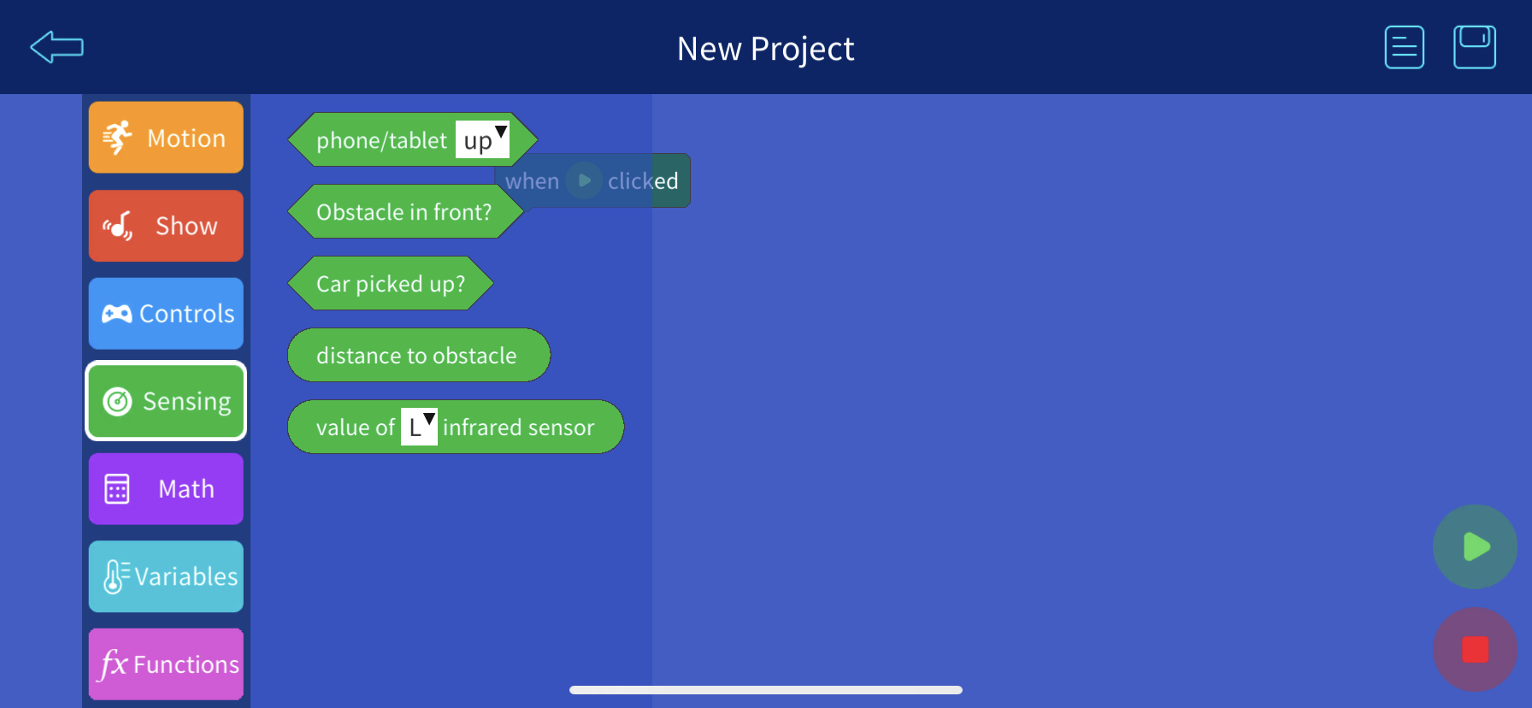
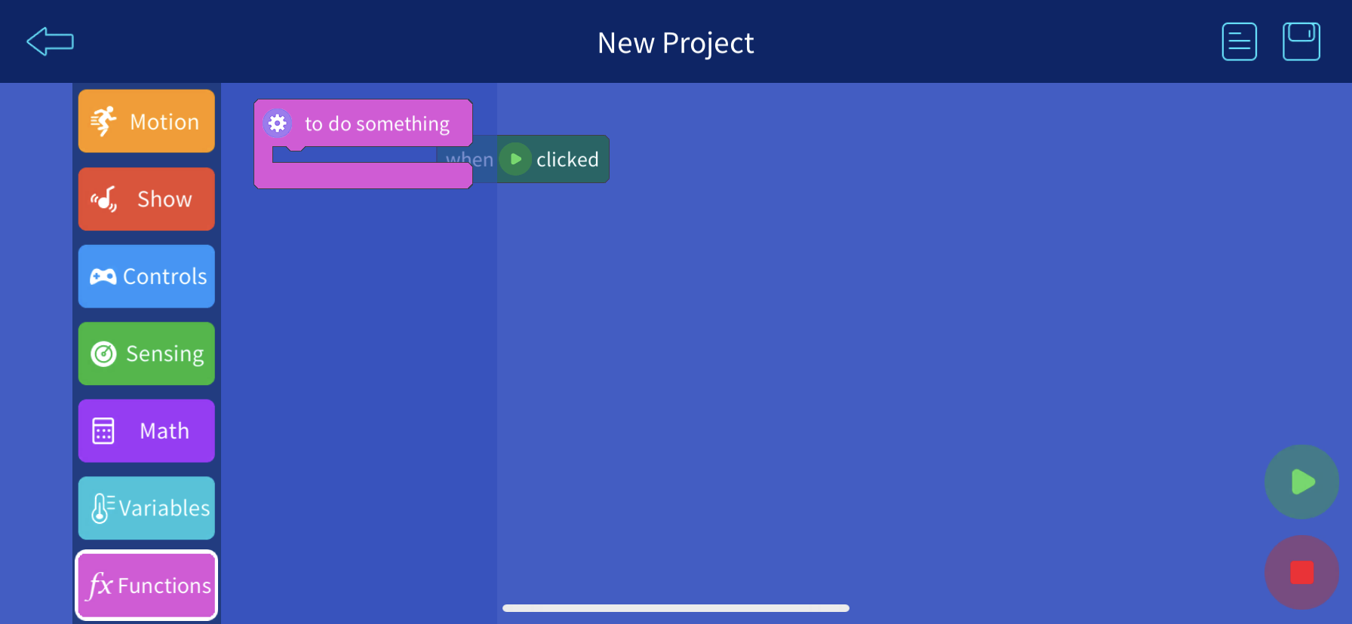
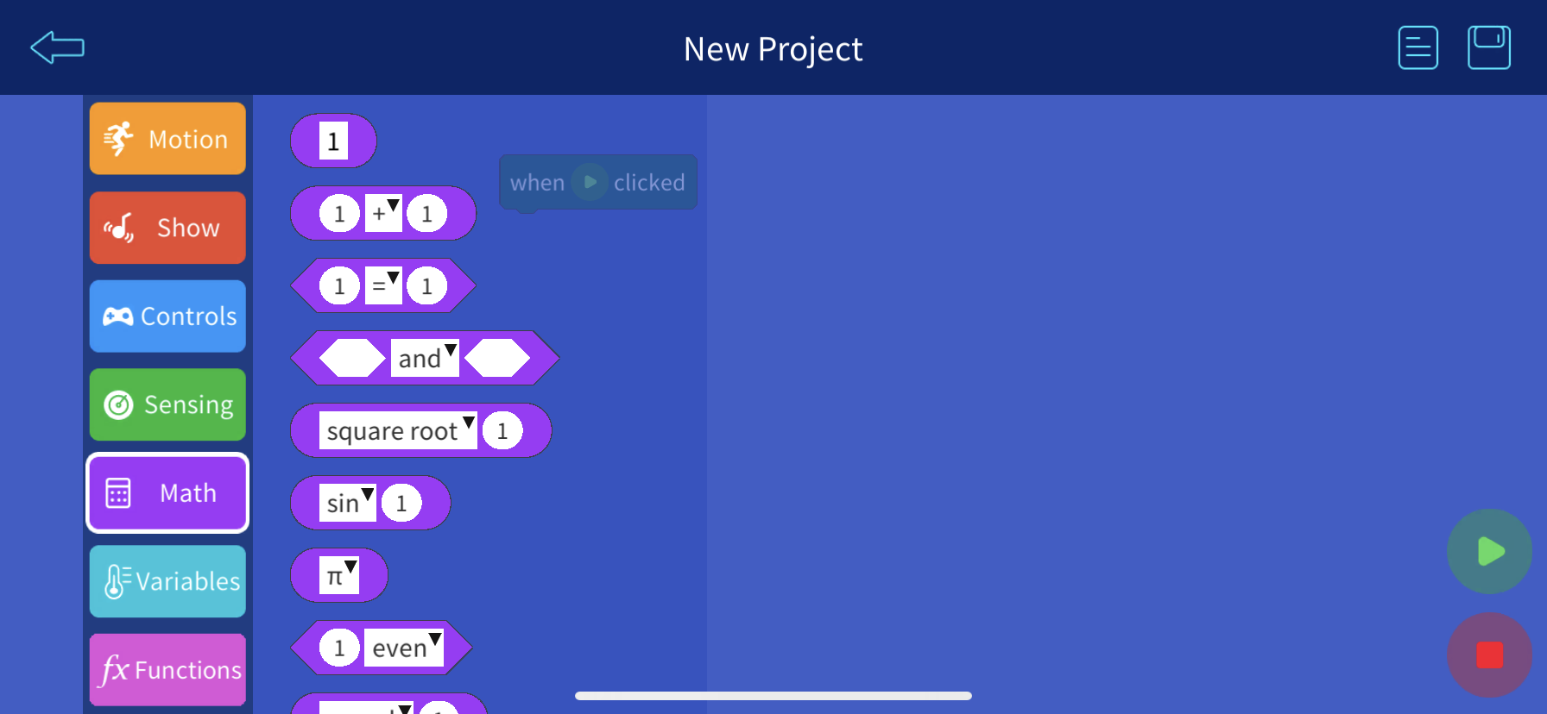
Basic building blocks

Slide 4
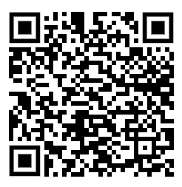
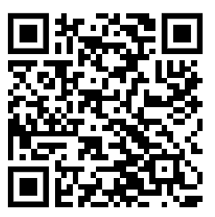
Let’s build something
Download the ElegooKit app
Android
iOS

Slide 5
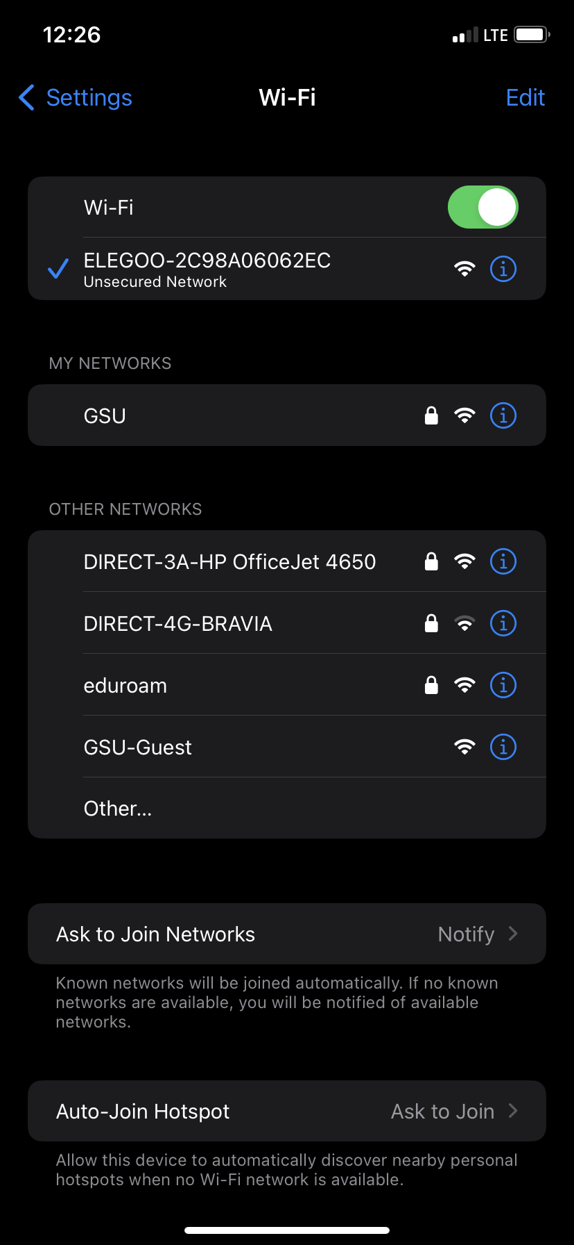
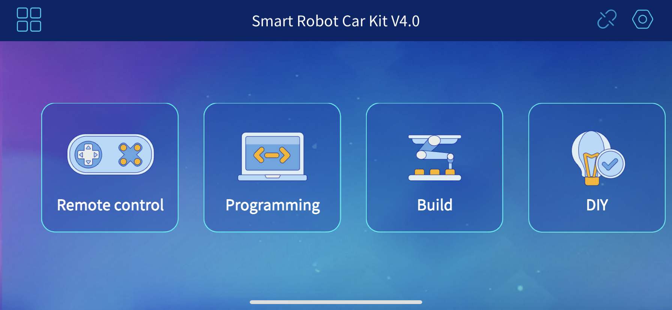
Connect to the car
Each car hosts its own Wi-Fi access point. Turn on the car and connect to its Wi-Fi.
First connect your phone to the WiFi network of the car
Usually Wi-Fi network start with ELEGOO-xxxxxx
Once connected open the app and connect to the Wi-Fi
network

Slide 6
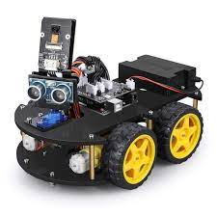
How it work
Scratch App
API endpoint
ESP32
Logic converter
Control functions Arduino
Wi-Fi (get/put)
Actuator Electronics
Motor Control Chip
Web Client

Slide 7
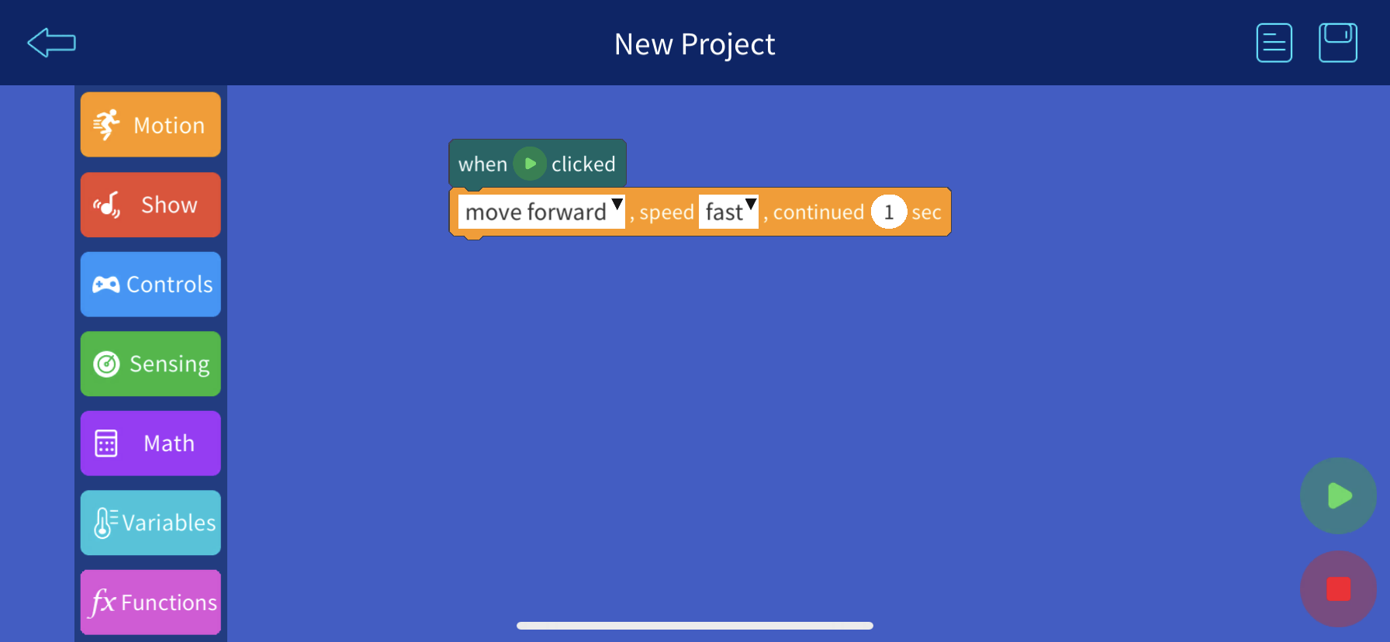
Let’s build Frist program
Let’s move the car forward for 1 second
There are few motion blocks available in the app
If we drag one of them to the action area, we can execute its’ action
If everything is setup correctly, when you click green arrow, car should move for 1 second and stop

Slide 8
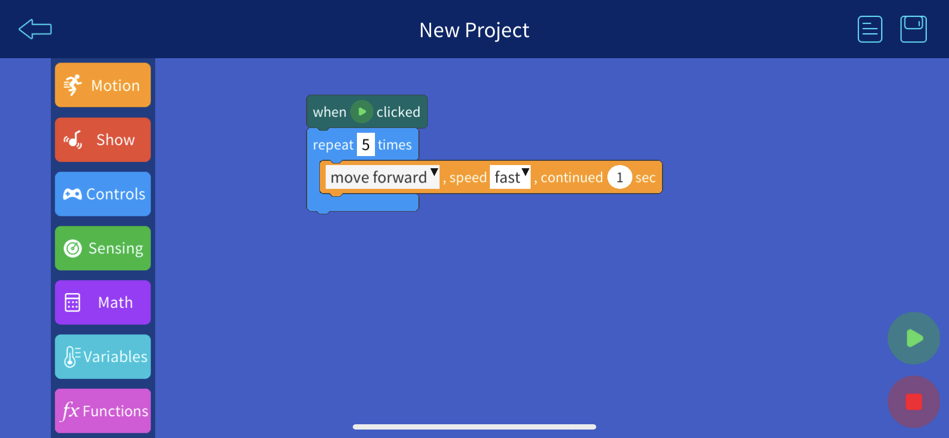
Building blocks - controls
In the above section, car moved for 1 second and stop.
Program execution has stopped
What is we want to execute some action repetitively, or want to execute an action based on a condition?
We can use control blocks
Let’s repeat the above action 5 times

Slide 9
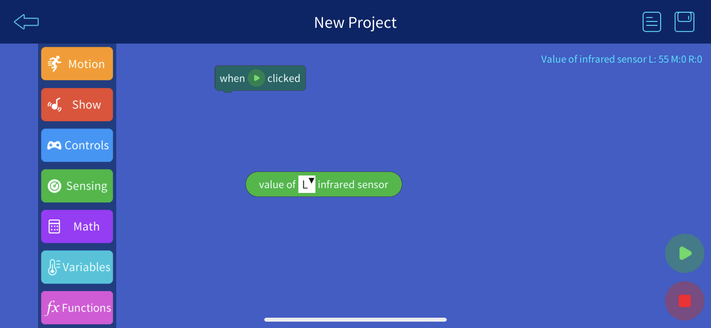
Reading sensor outputs
Our car has multiple sensors
These sensors read different measurements and report it
If you use one of the sensing blocks, it will report the value of that sensor periodically
Let’s try the infrared sensor and see it’s action
Place the sensor block into the program action are and execute the program, you will see value return back

Slide 10
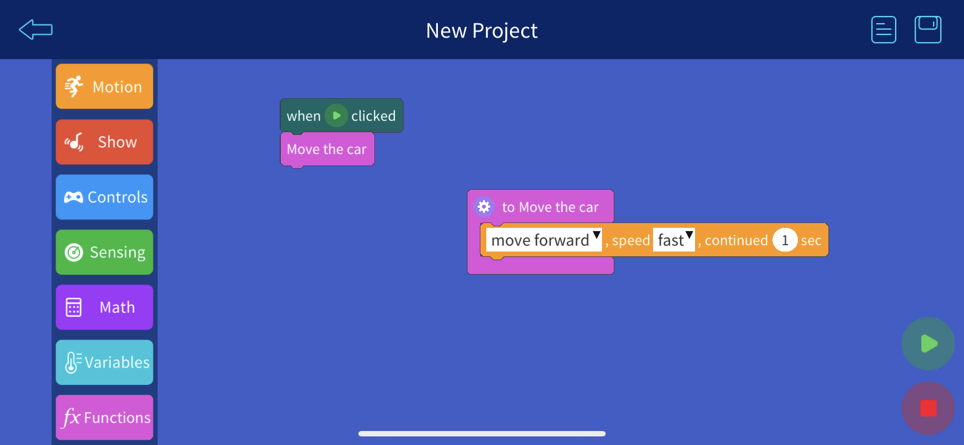
Creating complex logics
Sometimes when creating complex logic it is easy to group some logic together. We can use functions to do this.
In this example, we have created a function called move the car, and move the action inside the function. Now in the program beginning, we call the function move the car, function execute the car movement block.

Slide 11
Exercise
Create a program that move the car forward but stop it when it detect an obstacle.

Slide 12
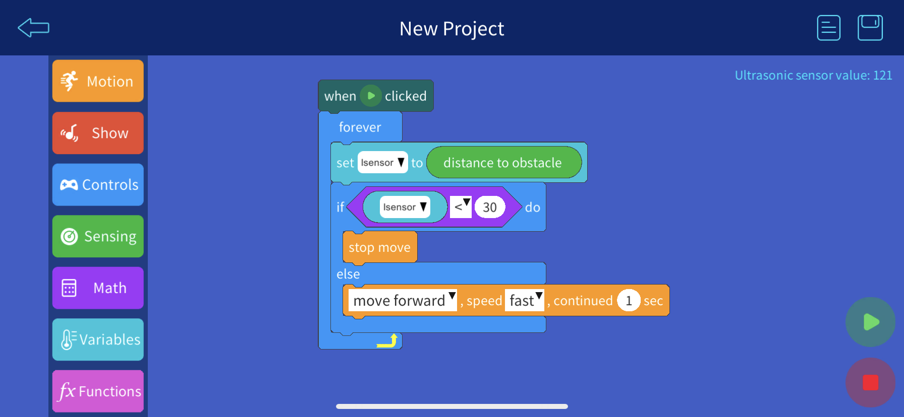
Solution

